Slide 1
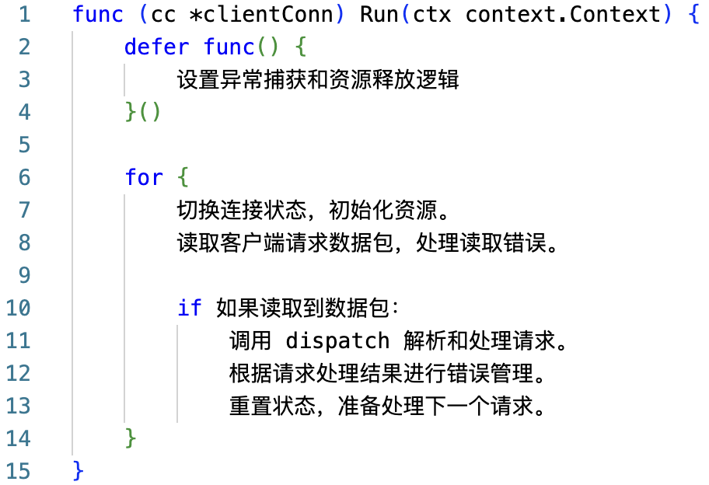
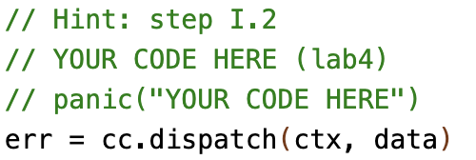
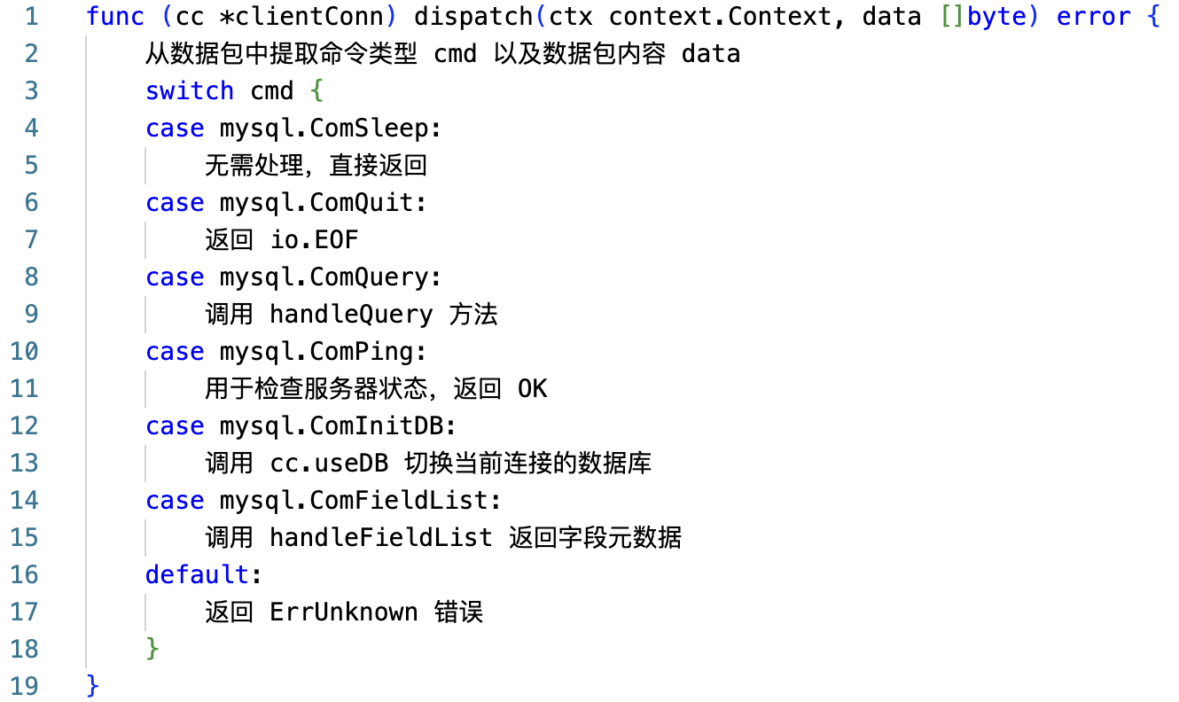
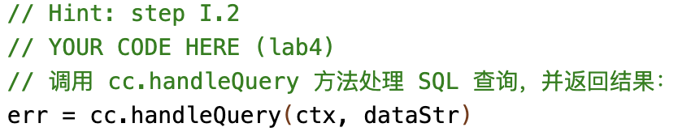
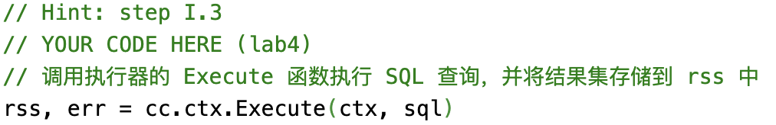
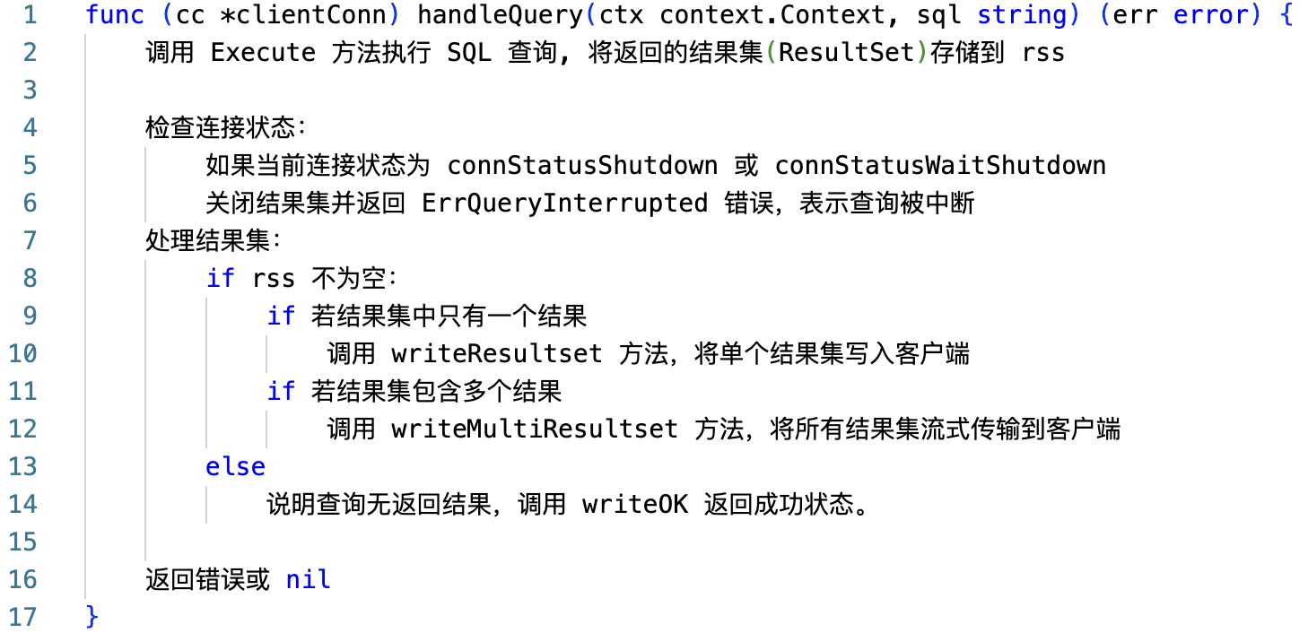
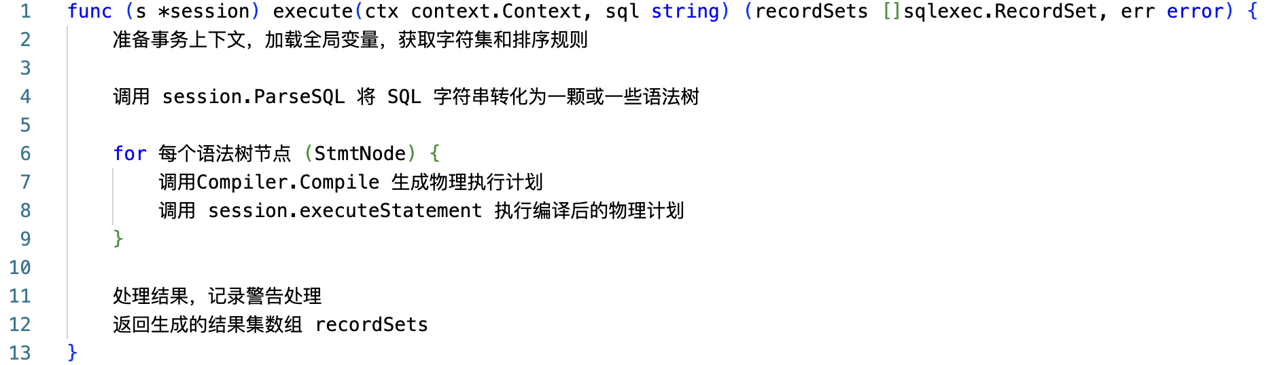
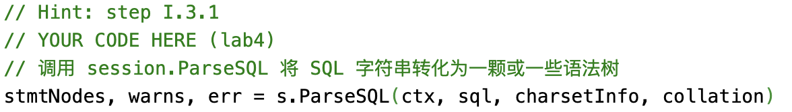
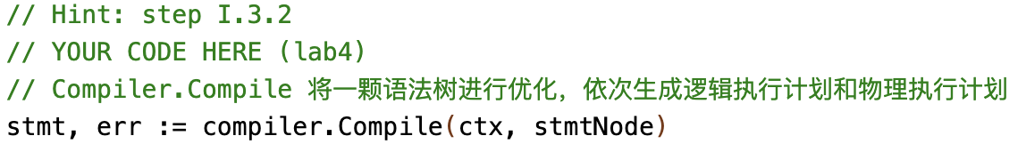
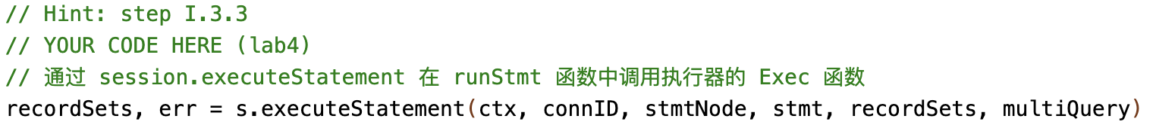
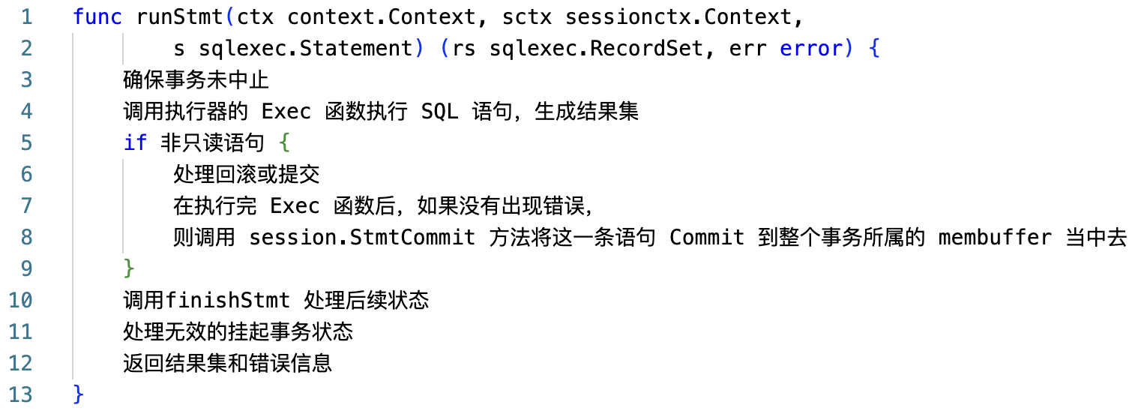
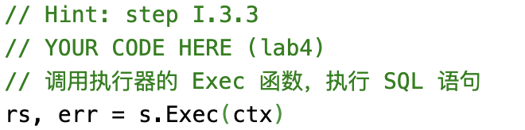
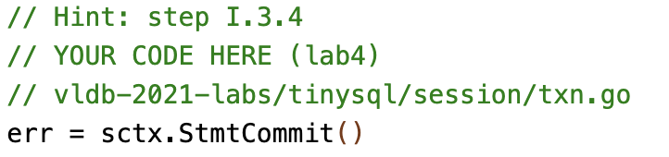
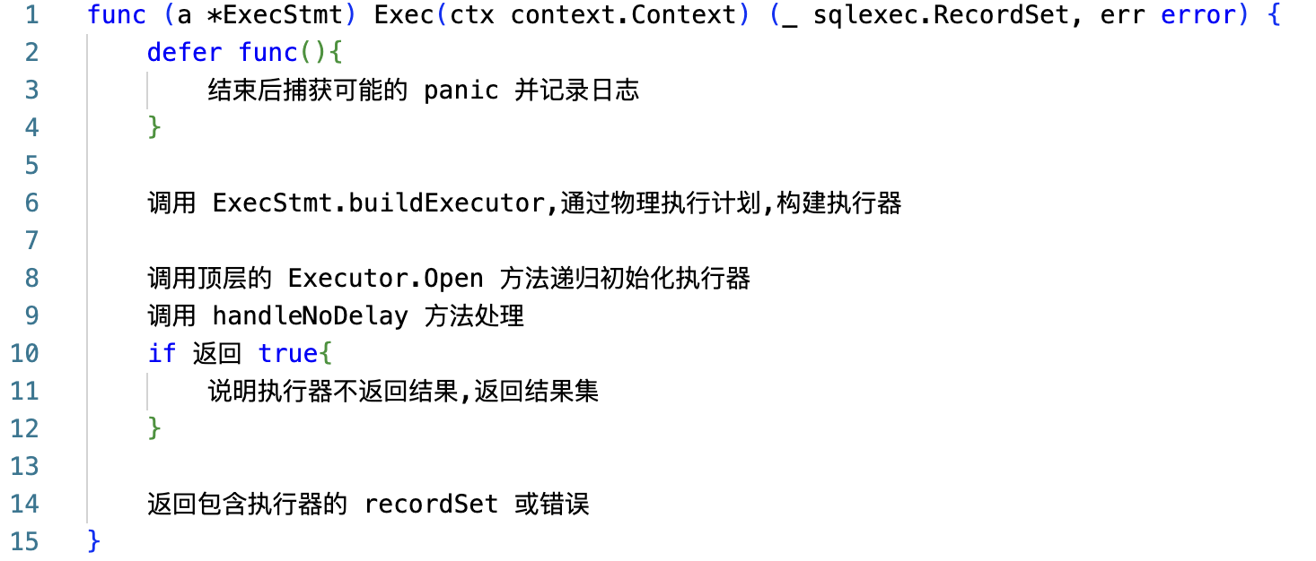
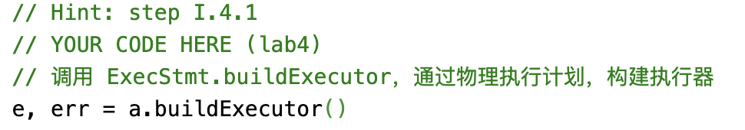
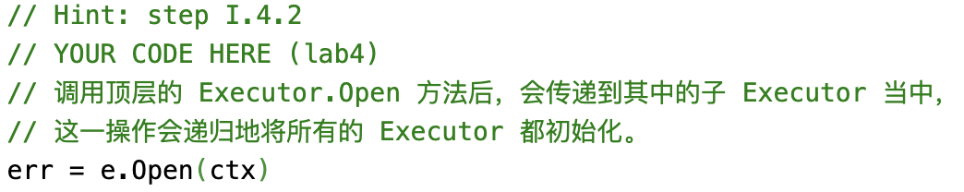
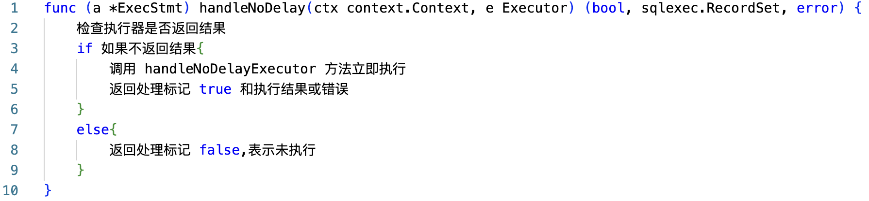
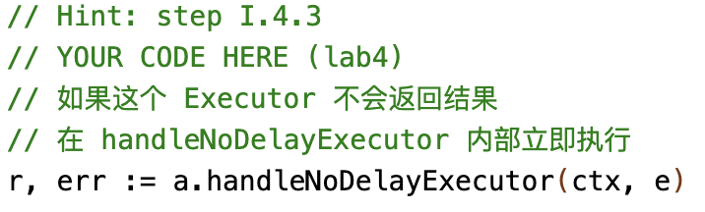
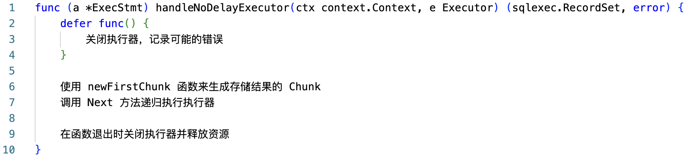
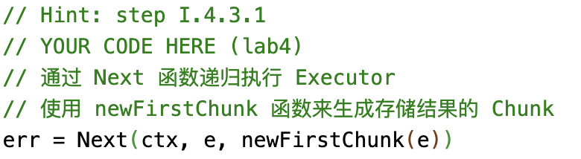
server/conn.go
clientConn.Run( )
处理结果
返回
server/conn.go
关注SQL请求
clientConn.dispatch( )
server/conn.go
TiDBContext.Execute( )
{
session.Execute( ){
session.execute( )}
}
clientConn.handleQuery( )
结果集
返回
session/session.go
session.execute( )
结果集
返回
session.executeStatement( ){
runStmt（）
}
session/tidb.go
runStmt( )
session/adapter.go
结果集
返回
ExecStmt.Exec( )
session/adapter.go
ExecStmt.handleNoDelay( )
session/adapter.go
ExecStmt.handleNoDelayExecutor( )

Slide 2
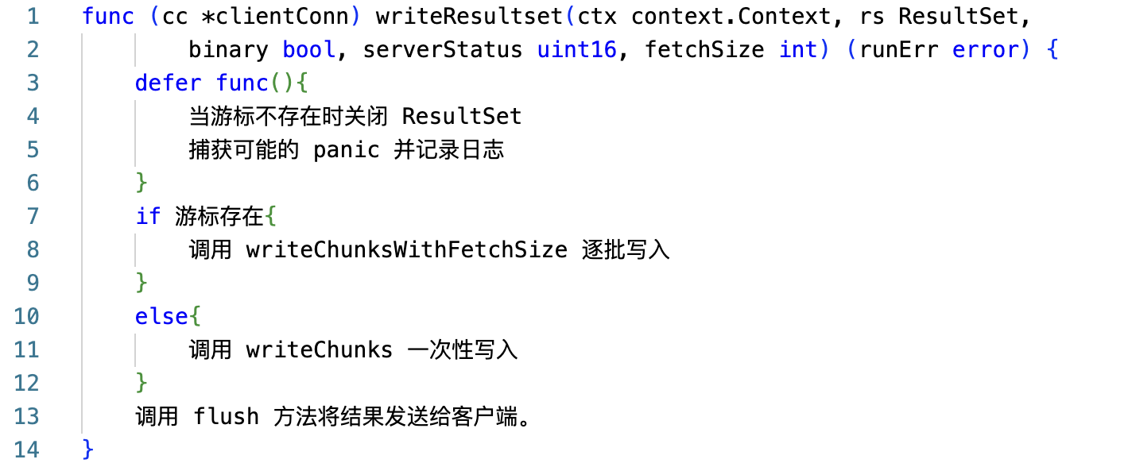
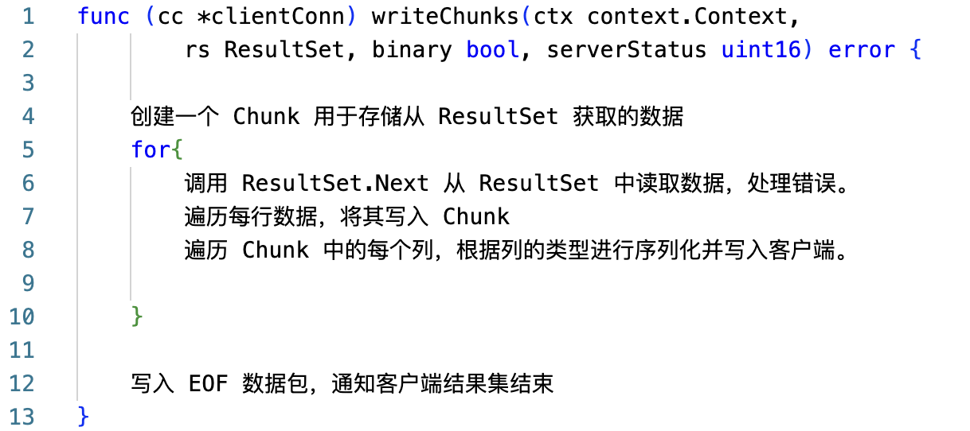
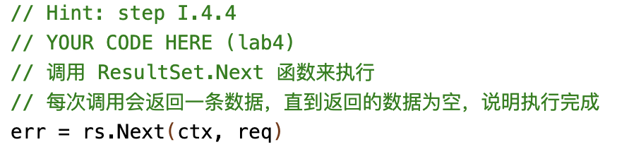
server/conn.go
clientConn.Run( )
处理结果
返回
server/conn.go
关注SQL请求
clientConn.dispatch( )
server/conn.go
clientConn.handleQuery( )
server/conn.go
clientConn.writeResultset( )
server/conn.go
clientConn.writeChunks( )
返回结果集不为空的情况

Slide 3
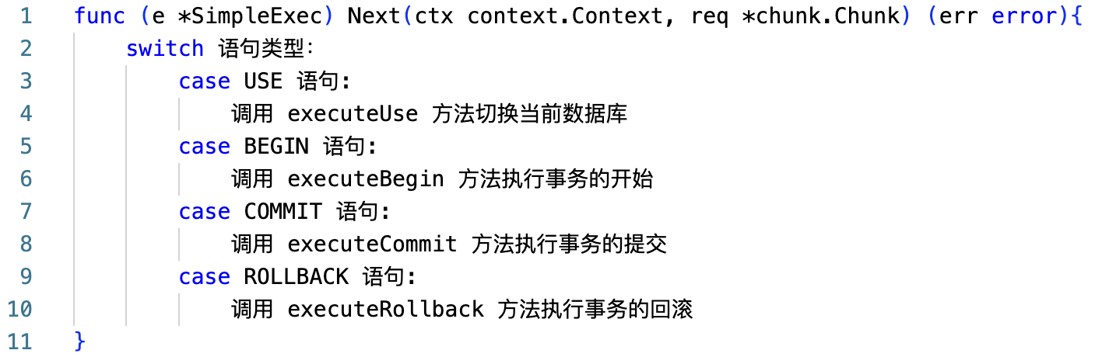
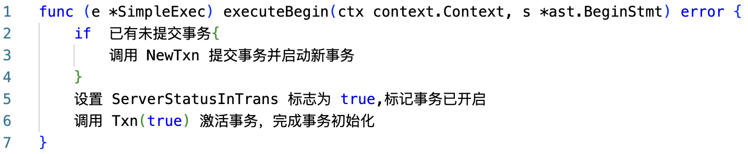
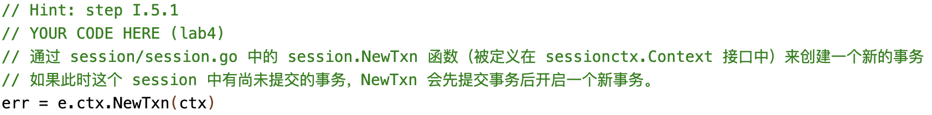
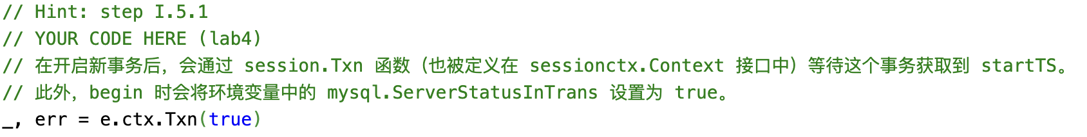
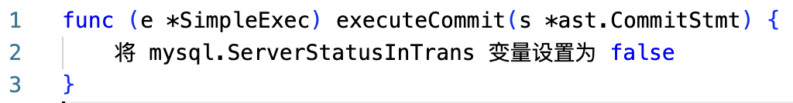
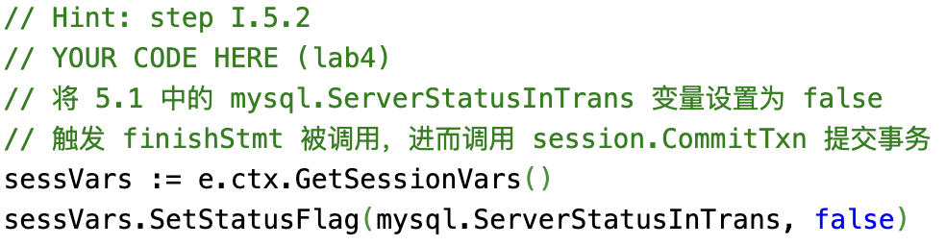
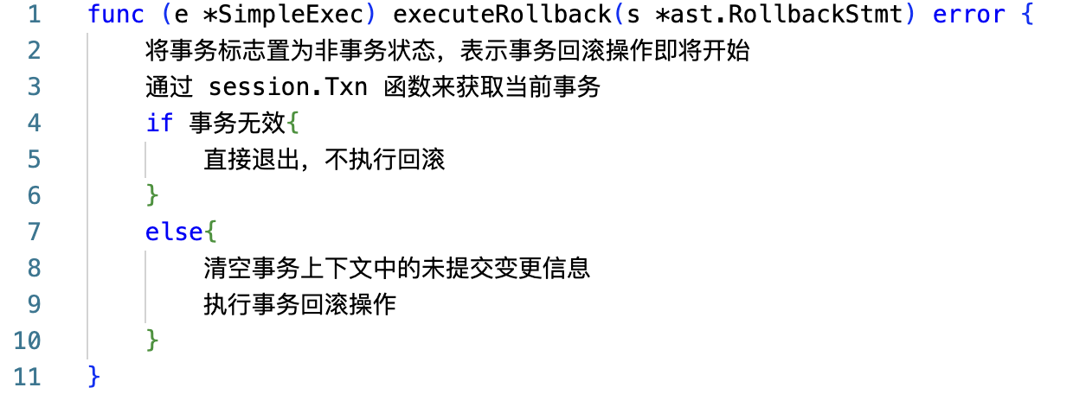
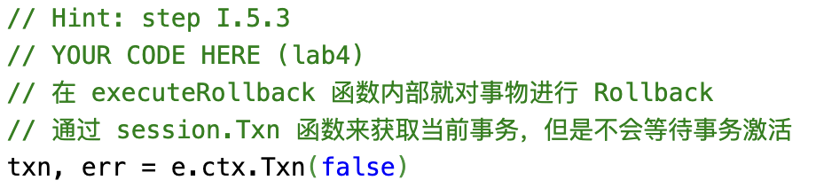
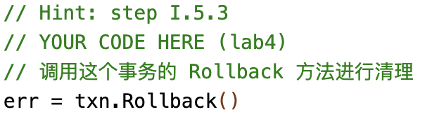
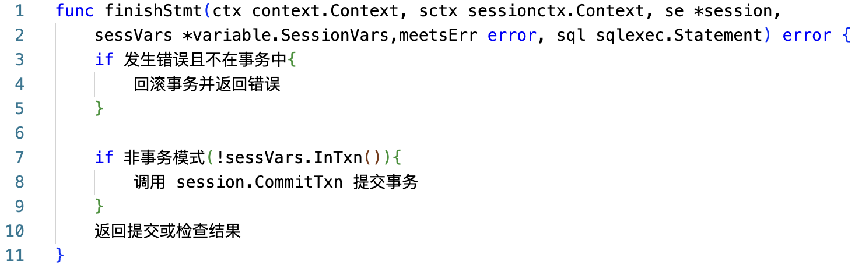
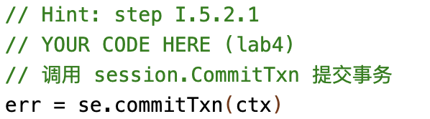
几种特殊的执行器
的执行入口
session/tidb.go
runStmt( )
executor/simple.go
SimpleExec.Next( )
executor/simple.go
SimpleExec.executeBegin( )
executor/simple.go
SimpleExec.executeCommit( )
executor/simple.go
SimpleExec.executeRollback( )
导致 sessVars.InTxn( ) 的返回值为 false，
在此时提交事务
session/tidb.go
finishStmt( )

Slide 4
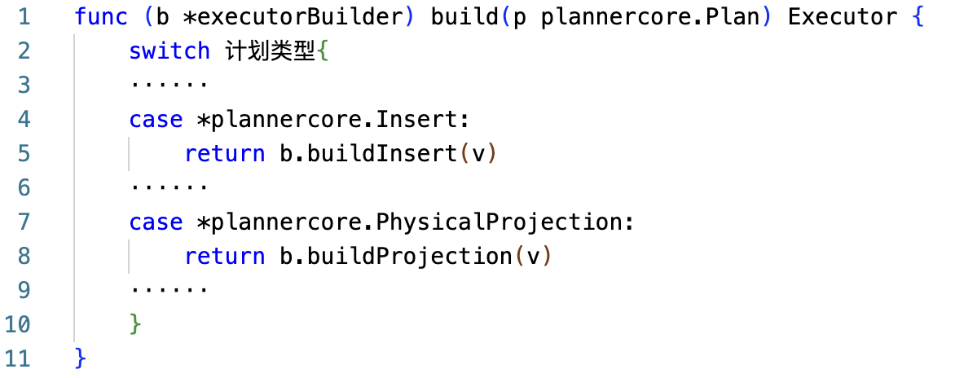
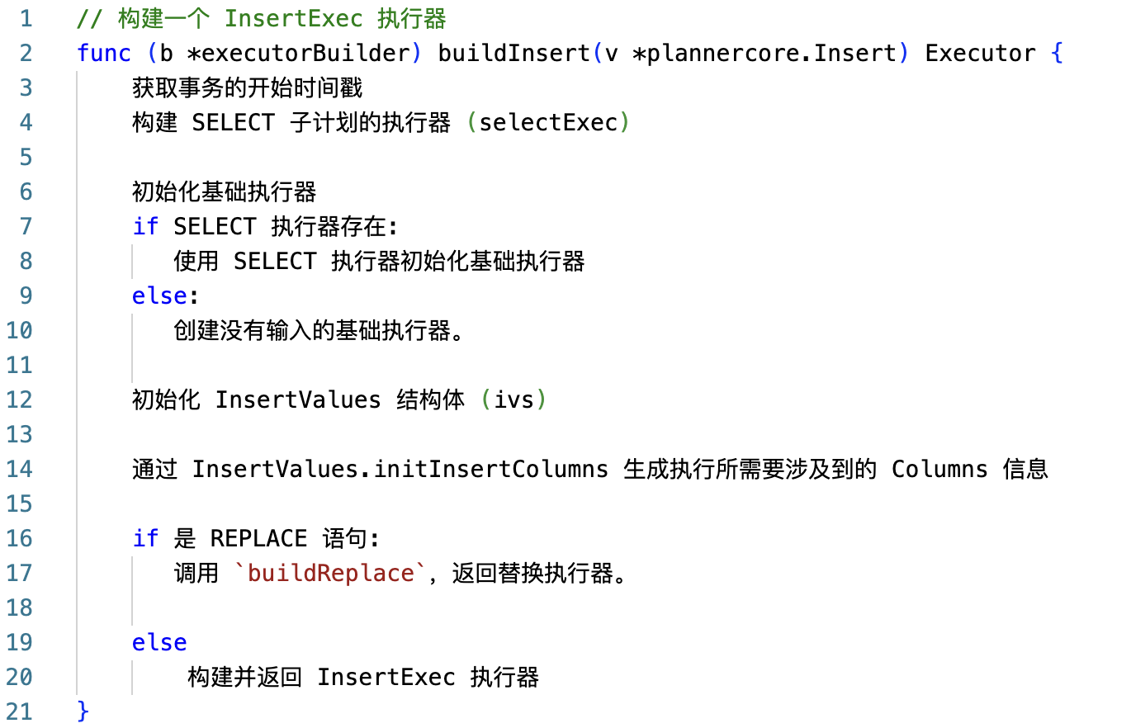
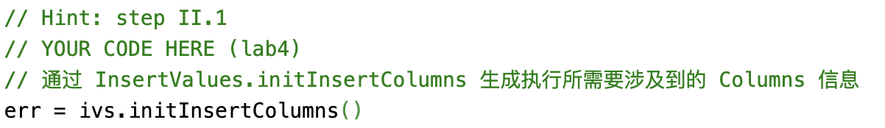
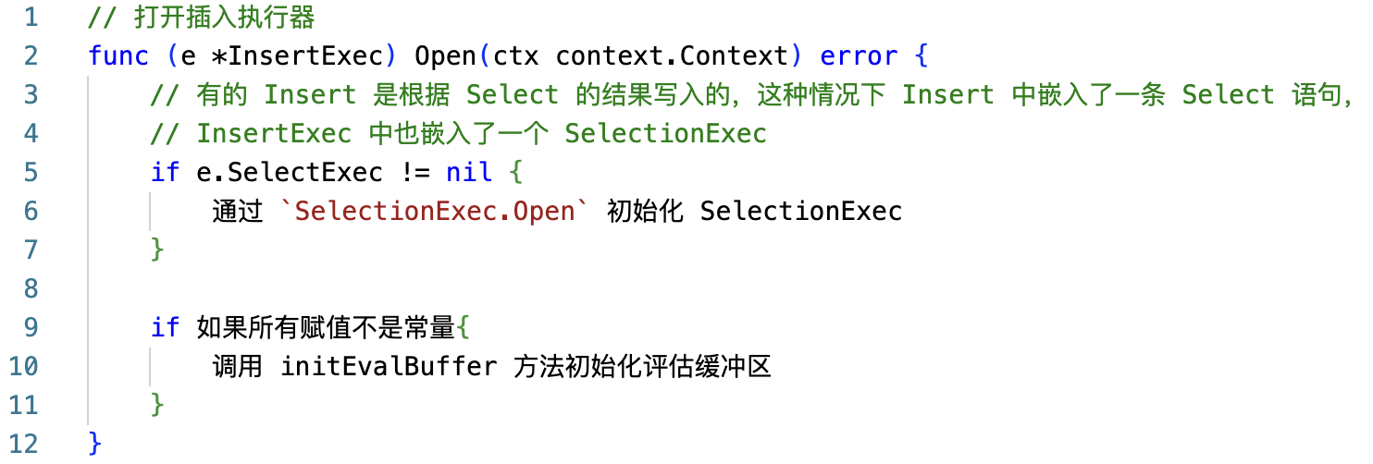
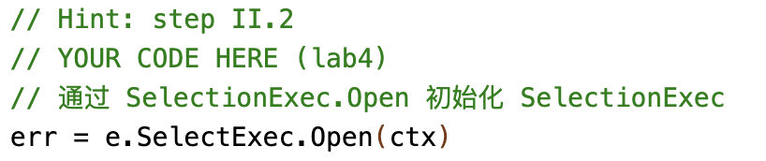
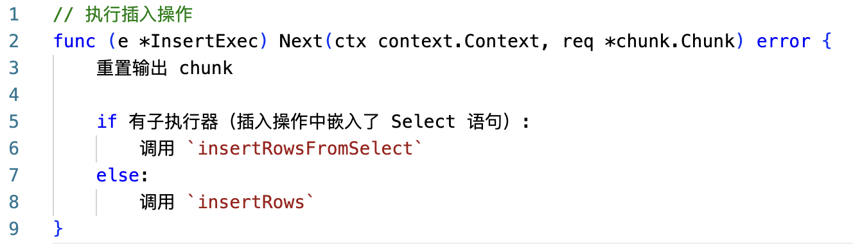
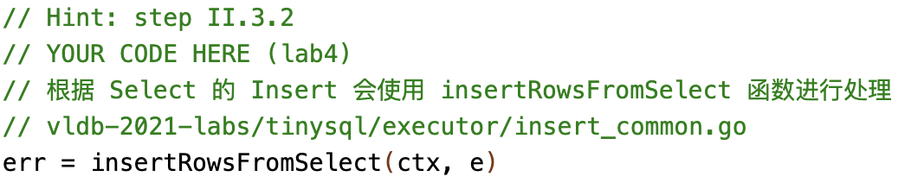
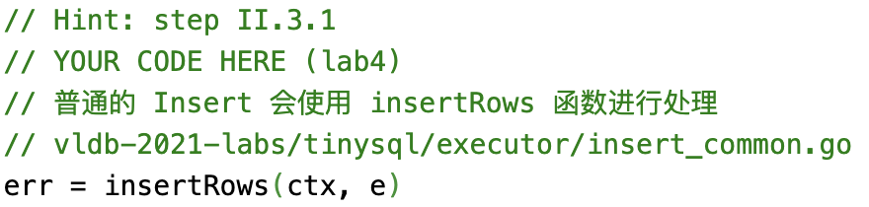
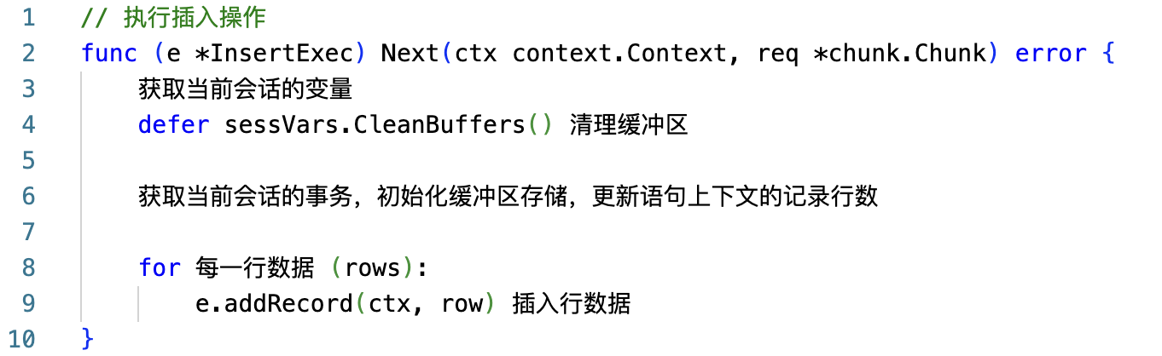
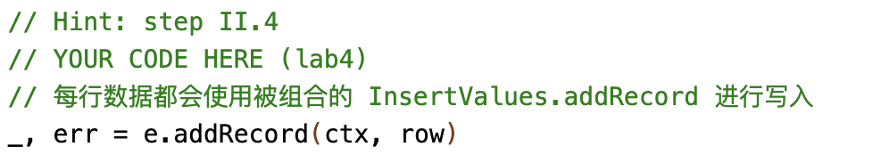
session/adapter.go
ExecStmt.Exec( )
执行器
返回
ExecStmt.buildExecutor( ) {
executorBuilder.build( ) }
executor/builder.go
executorBuilder.build( )
执行器
返回
executor/builder.go
executorBuilder.buildInsert( )
executor/insert.go
InsertExec.Open( )
handleNoDelay( ) {
handleNoDelayExecutor( ) }
session/adapter.go
ExecStmt.handleNoDelayExecutor( )
executor/insert.go
InsertExec.Next( )
insertRows( )和 insertRowsFromSelect( ) 都会使用 InsertExec.exec( )来处理实际写入的数据
executor/insert.go
InsertExec.Exec( )

Slide 5
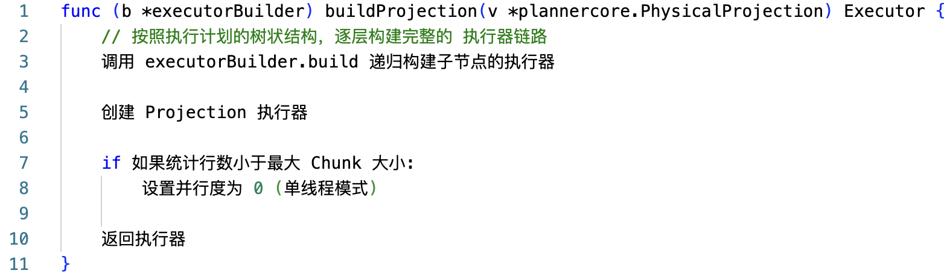
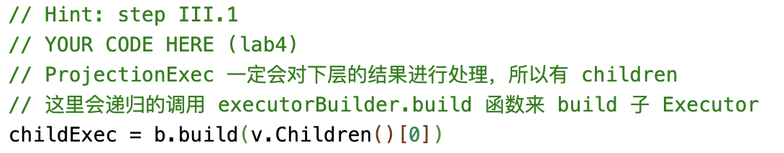
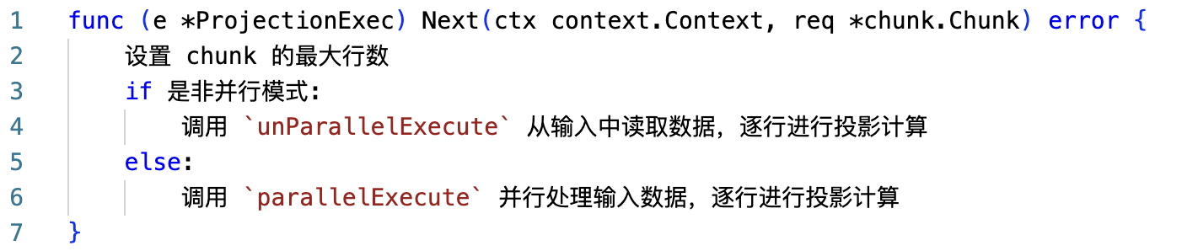
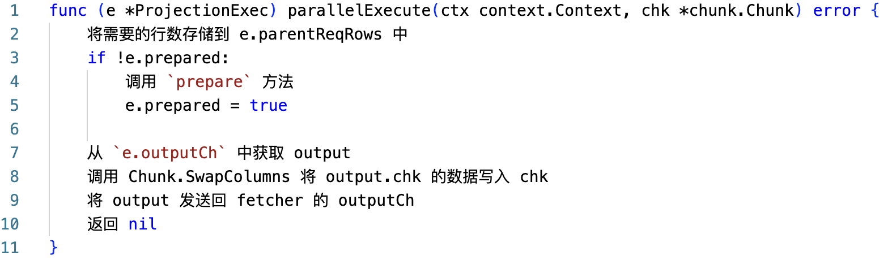
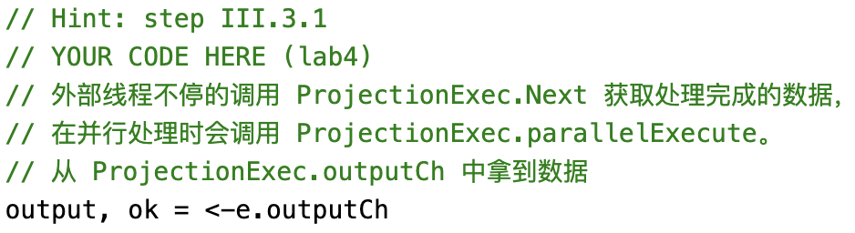
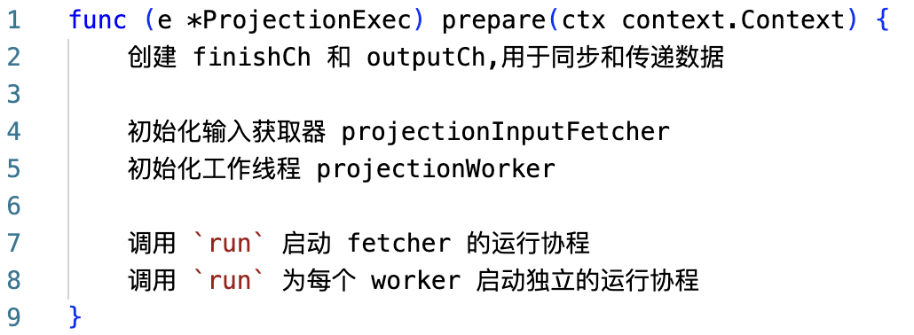







session/adapter.go
ExecStmt.Exec( )
执行器
返回
ExecStmt.buildExecutor( ) {
executorBuilder.build( ) }
executor/builder.go
executorBuilder.build( )
执行器
返回
executor/builder.go
executorBuilder.buildProjection( )
handleNoDelay( ) {
handleNoDelayExecutor( ){
next()}}
executor/projection.go
ProjectionExec.Next( )
executor/projection.go
ProjectionExec.parallelExecute( )
executor/projection.go
ProjectionExec.prepare( )
executor/projection.go
executor/projection.go
N
ProjectionInputFetcher.run( )
ProjectionWorker.run( )

